Slide 1

Palliative Care Quality Collaborative (PCQC)
Improving Quality, Together

Slide 2







PCQC Created Through Partnership:
Funded by the Gordon and Betty Moore Foundation and the Cambia Health Foundation
Notes:
Steve

Slide 3
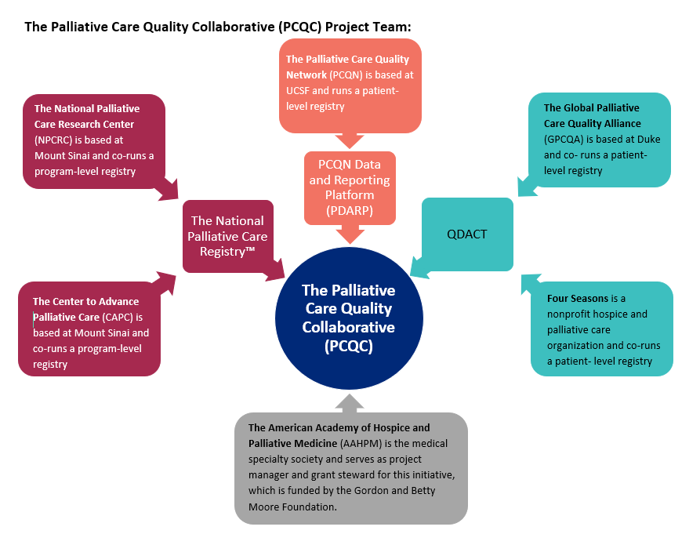
PCQC
PCQC is a new 501(c)(3) organization that will house a new national palliative care data registry system that will capture both program and patient-level quality data.
The goal is to have the new registry system operational in early 2021.

Slide 4
Palliative Care Quality Collaborative (PCQC)
The PCQN project is merging with the GPCQA project and the National Palliative Care registry (a structure and process registry run jointly by CAPC and the NPCRC) to create a new, single PC quality measurement and improvement organization for our field.
The PCQC is an independent, non-profit organization with a Board of Directors, staff, and technology vendor with the goal of seamless integration and data extraction from the electronic health record.
The patient-level data is very similar to what is currently being collected through PCQN and GPCQA with some updates. We have updated the patient-level outcome data dictionaries and the structure and process data dictionary accordingly.
We will make the structure/process database available for free to all programs and charge a membership fee (similar to what we already do in PCQN and GPCQA) for the patient-level outcome registry.

Slide 5
Why You Should Join PCQC
Improve Patient Care
Demonstrate Value
EHR Integration
Palliative Care Quality Measures
Quality Services
Value Based Purchasing
Learning Health System
Networking and Collaboration
Standardization and Benchmarking
Research
Improve patient care through rapid cycle quality improvement
Empower palliative care service providers to demonstrate their value to health systems
Provide the capacity for EHR integration
Assure the quality of palliative care services
Design, test and implement quality measures that matter for seriously ill patients
Collect and report data on quality measures in value-based purchasing agreements with payers
Create a learning health system for the seriously ill
Create a national peer network and collaborative quality projects
Ensure that data from different providers measures the same thing – using a standardized approach to increase confidence, consistency, reliability, and benchmarking capabilities
Improve palliative care research efforts

Slide 6


PCQC Mission
Transforming healthcare by measuring, defining, and promoting quality palliative care through national learning collaboratives.
PCQC is committed to improving the care of seriously ill patients and their families.

Slide 7








PCQC Board of Directors
Melissa D. Aldridge, PhD, MBA, MPH,
Mount Sinai
Diane E. Meier, MD, FACP, FAAHPM,
CAPC, Mount Sinai
Janet Bull, MD, MBA
Four Seasons
Steven Pantilat, MD,
University of California San Francisco
Kristyn Fazzalaro, LCSW, ACHPSW,
Hoag Health Network
Phillip E. Rodgers, MD
University of Michigan, Medical School
Arif H. Kamal, MD, MBA, MHS,
Duke University
Rachel Thienprayoon, MD, MSCS,
Cincinnati Children’s Hospital

Slide 8

PCQC Project Team

Slide 9
PCQC has hired ArborMetrix to build the registry system

Slide 10

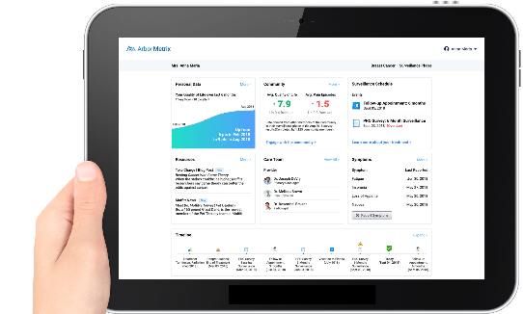
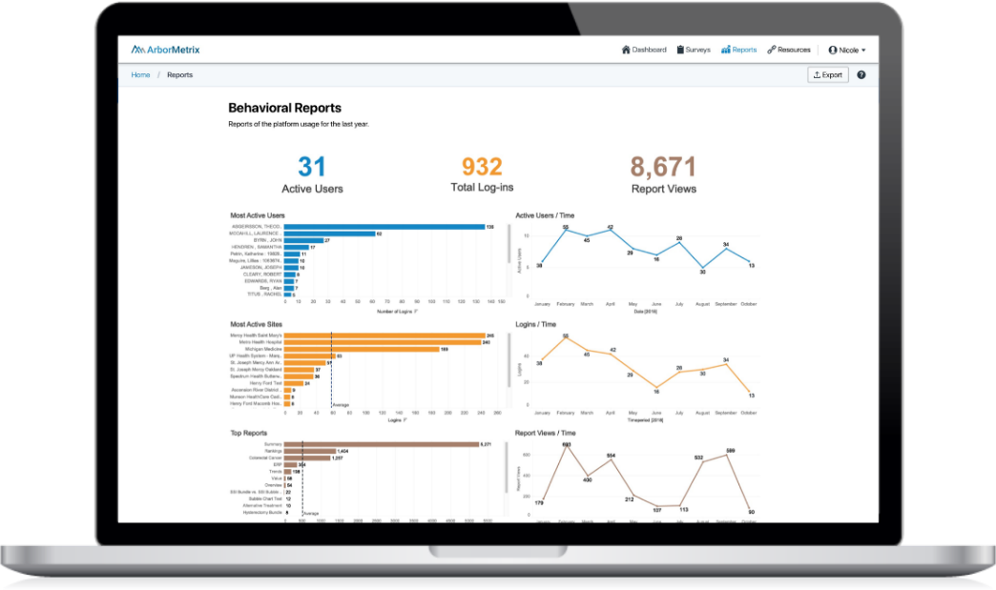
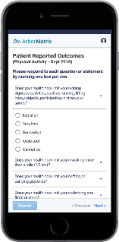
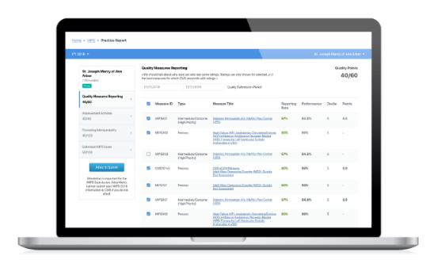

Example of an ArborMetrix Registry Product
Patient Engagement Suite
Registries on ArborMetrix Registry^{X}
Data Acquisition
EMR Integration
Builder
Survey
Dashboard
Embedded Data Science
Advanced Analytics
Risk & Reliability Adjustment
Smart Web Forms
CMS Quality Reporting for MIPS

Slide 11

Data Science and Analytics
Industry-leading expertise in the transformation of real-world data into real-world evidence for research and quality improvement
Clinically meaningful measures
Scientific statistical models
Real-time analytic processing
*Example of an ArborMetrix registry product

Slide 12

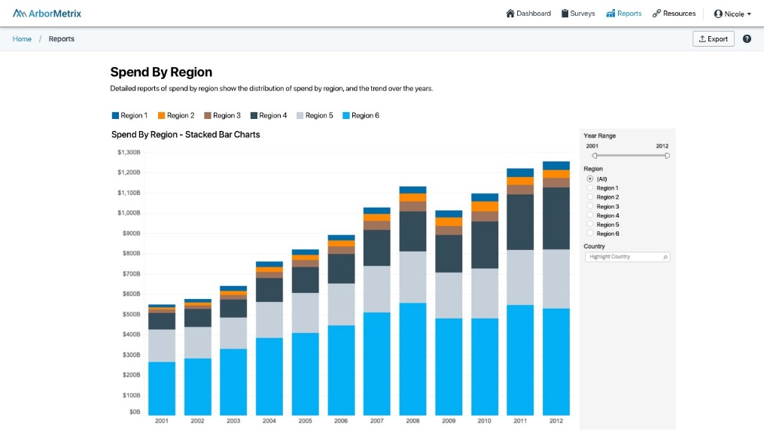
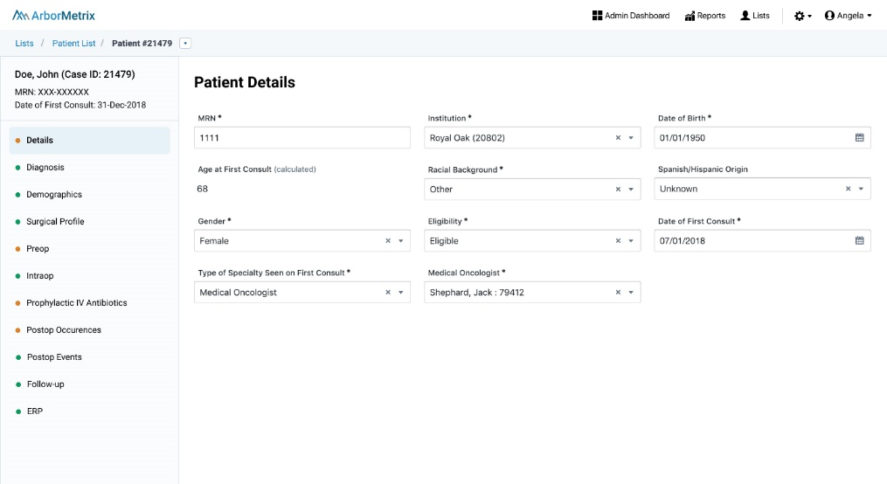
Visualizations and Interactive Experience
ArborMetrix Registry^{X} provides access to all patient details with flexible reporting.
Patient details can be viewed, modified and exported.
Reporting and visualizations powered by Tableau.
*Example of an ArborMetrix registry product

Slide 13
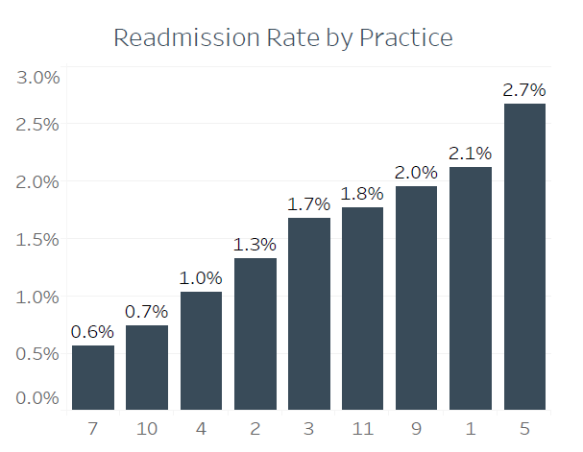
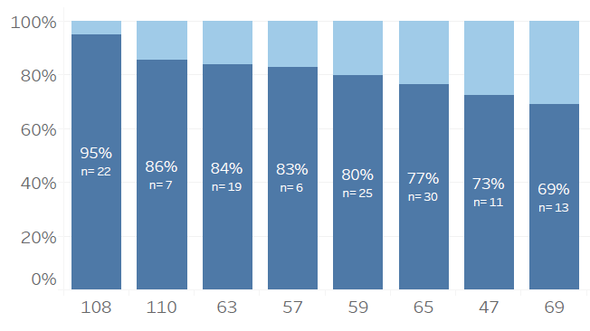
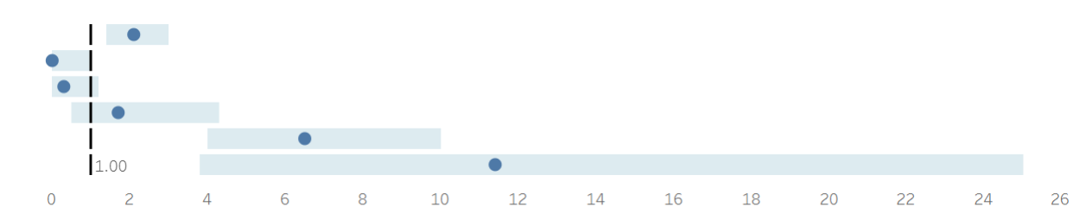
Variety of Visualizations
*Example of an ArborMetrix registry product

Slide 14
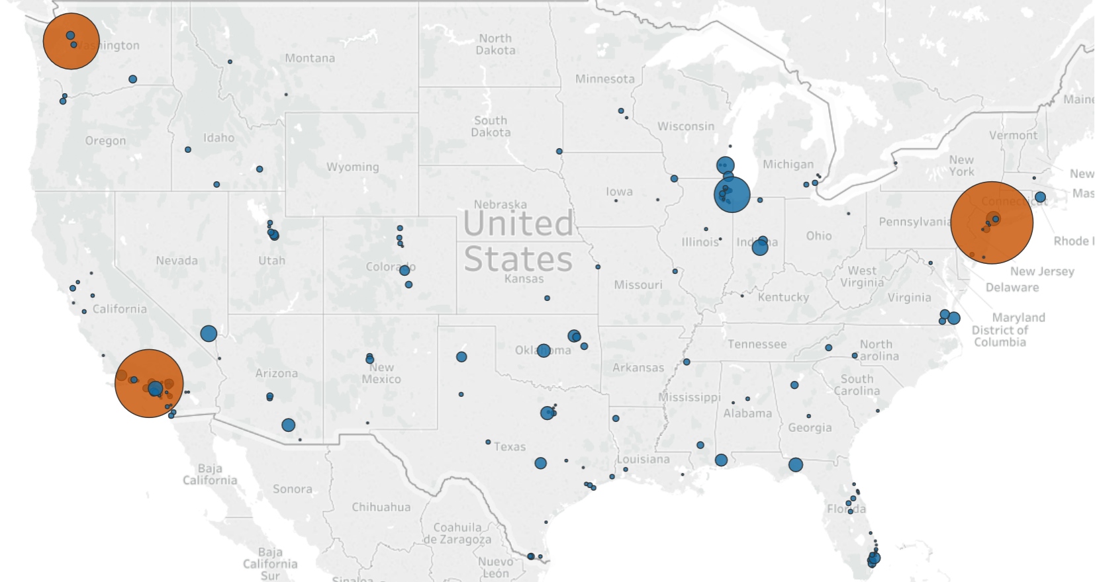
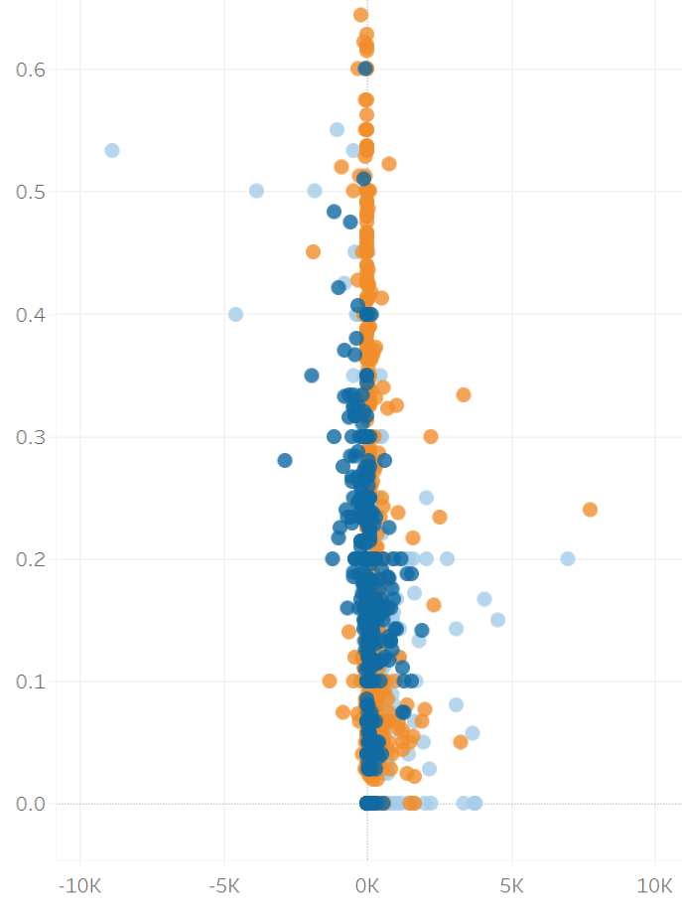
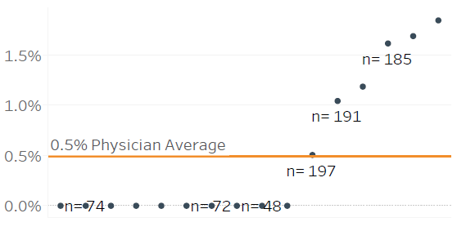
Variety of Visualizations
*Example of an ArborMetrix registry product

Slide 15
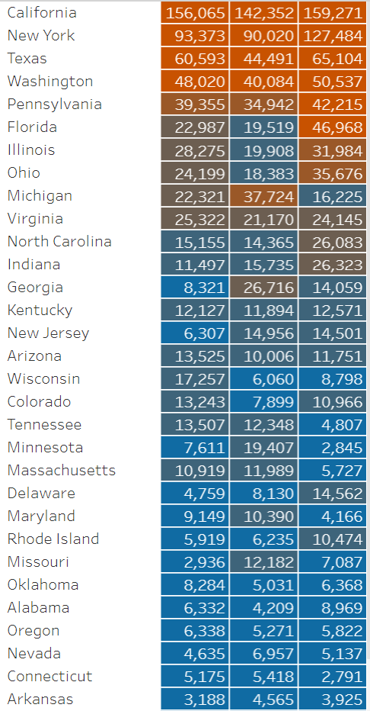
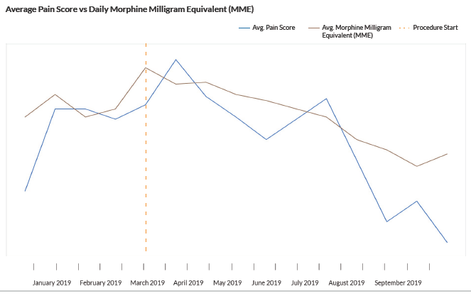
Variety of Visualization
*Example of an ArborMetrix registry product

Slide 16




PCQC: Leveraging data to improve care
DATA
KNOWLEDGE
ACTION

Slide 17
The PCQC Registry
Development
Informed by national guidelines
Consensus project with input from PCQC members
Dataset
Core and Optional items
Patient-level outcomes
Feasible, clinically meaningful, prospective
Supports standardized assessment

Slide 18

PCQC Registry Data Elements
Patient Characteristics
  Dem, Diag, Reason for consult, referral source
Process of Care
  Dates, team, screening & interventions
Advance Care Planning
  SDM doc, AD & POLST completion
System Scores
ESAS, quality of life
Disposition
  Status, services

Slide 19




PCQC Registry Reports
Summary
Stats on core & optional data elements
Trend
Over time for various user selected measures
Member Comparison
Benchmark reports to appropriate cohorts
Database Queries

Slide 20

PCQC Quality Collaborative
Use peer-to-peer learning
Virtual, online
QI Projects
  Review and discuss data
  Sharing strategies
  Peer support
QI Education

Slide 21
Join the PCQC Community Online and In-Person
Webinars
Member led and Content experts
Specific topics and case review
Strategy Exchanges
EHR Integration
Longitudinal Learning
Single topic, Multiple Sessions
PCQC Meetings
Annual
Regional, In-person Conferences
Engage with PCQC on Social
Twitter @palliativequal
LinkedIn PCQC company page

Slide 22
Joining PCQC
Commitment to:
data collection & entry
improving quality of care; and
sharing ideas
Membership Agreement (MOU + BAA)
Annual Fee
Completion of basic program-level online survey

Slide 23
Reach out to get more information about the PCQC
Join us!
Are you a potential registry participant with questions? Contact:
→ The Palliative Care Quality Collaborative (PCQC)– info@palliativequality.org

