Slide 1


Making Measurement Matter:
How Will Your Organization Engage with the New Palliative Care Quality Collaborative?
Arif Kamal, MD, MBA, MHS
Joe Rotella, MD, MBA
Maggie Rogers, MPH
Steven Pantilat, MD
May 20, 2020

Slide 2
With Gratitude
Content from this presentation was originally created for the 2020 AAHPM and HPNA Annual Assembly
Thank you to AAHPM for their support in co-hosting today’s webinar

Slide 3




PCQC created in partnership with

Slide 4
Funded by

Slide 5
Disclosure
Joe Rotella has no relevant disclosures.
Maggie Rogers has no relevant disclosures.
Steve Pantilat has no relevant disclosures.
Arif Kamal is CEO of Prepped Health and CMO of Acclivity Health

Slide 6

Good to Great: Excel to Acceleration

Slide 7
Session Objectives
Describe the benefits of quality registry participation for palliative care programs
Review the advantages and opportunities when palliative care organizations measure and compare quality across peers and have the opportunity to network with colleagues
Discuss the services provided by the PCQC in assisting palliative care practices today in quality measurement, benchmarking, reporting, and education

Slide 8
Historical Context

Slide 9
Quality
Value = Quality/Cost
Three-part aim of health care reform
  Better health outcomes
  Better experience of care
  Lower per capita cost
  With engaged, resilient clinicians

Slide 10
Quality Medical Care
“The degree to which health services for individuals and populations increase the likelihood of desired health outcomes and are consistent with professional knowledge.”
Institute of Medicine

Slide 11
IOM 6 Dimensions of Quality
Safe
Effective
Patient-centered
Timely
Efficient
Equitable
Crossing the Quality Chasm: A New Health System for the 21st Century (2001)

Slide 12
Why Measure Quality?
Payers and accreditors demand it
We must show value to partners and payers
Quality increasingly linked to payment
Our patients and families deserve the best possible care and service− always connect back to what will make a difference for them!

Slide 13
The Secret of Quality is Love
“Systems awareness and systems design are important for health professionals, but they are not enough. They are enabling mechanisms only. It is the ethical dimensions of individuals that are essential to a system’s success. Ultimately, the secret of quality is love. You have to love your patient, you have to love your profession, you have to love your God. If you have love, you can then work backward to monitor and improve the system”
― Avedis Donabedian

Slide 14
National Quality Framework
Set priorities & goals
Develop & test measures
Endorse & harmonize measures
HIT specification & embed in EMR
Implementation strategies & Technical assistance
Data aggregation, benchmarks, registries
Public reporting
Public policy, including payment incentives
Improve quality & affordability
Continuously evaluate health & care
Quality Improvement
Adapted from the Consumer-Purchaser Disclosure Project: Idealized Framework for Quality and Cost Transparency for High-Value Care, QASC, January 2008
Notes:
Keela & Sydney

Slide 15
Driving Quality Improvement in Palliative Care
Clinical data registries
QI collaboratives
Denominators that capture all people living with serious illness
Electronic QMs that can be collected from EHRs
Surveys of experience of care administered before death
Further testing of PROs
Notes:
So, our current reality is that the instruments and quality measures and tools we have today are rudimentary and flawed.
But our field is driving toward a better future.
There are promising quality initiatives in development, pilot, or early adoption stages, including clinical data registries that gather patient-level data and allow benchmarking and comparison across programs and individual clinicians, quality improvement collaboratives where multiple practices work together to find and spread best practices, measures in development with broader denominators that can be applied to more of the people living with serious illness appropriate for palliative care, electronic clinical quality measures that are easily recorded during normal workflow and easily extracted for reporting and quality improvement.
Additional surveys of the patient’s experience of care will be developed for patients receiving palliative care outside of hospice, including a post-admission survey of living patients receiving community-based palliative care.
And, we are still in pursuit of patient reported outcomes that matter in palliative care. For an example of a promising PRO instrument, check out the Integrated Palliative Outcome Scale or IPOS. The website is pos-pal.org.

Slide 16
Getting the Most from Registries
Benchmarking structural data
  Supports requests for resources to ensure access and quality
  Can drive policy at state level (report cards)
Benchmarking clinical data
  Can identify gaps and best practices to empower QI that works
  Demonstrates value to payers, referral sources and patients
Powerful research tool for uncovering trends and correlating structures and processes with outcomes

Slide 17
Rallying the Troops for QI
Build enthusiasm for change
Use a patient story for why it matters
Connect the dots− how does this quality improvement program add value to care and experience of those we serve
Employ cross-functional work groups
Keep goals focused, simple and attainable
Celebrate even the smallest early successes

Slide 18
Program-level and Patient- level: Do we need both?
Basic Program Information
What is your program and where do you provide care?
Program-level Data
What does your program look like, how is it staffed, and how do you operate?
Patient-level Data
Patient characteristics, symptoms, patient outcomes
Benefit: Get listed on the Program Directory on getpalliativecare.org
Be counted in national studies on pal care availability
Benefit: comparative reports on program operations, staffing, and workload
Benefit: detailed reports for quality improvement, measurement, and benchmarking + QI collaborative

Slide 19
Program-level and Patient- level: Do we need both?
“As a newer medical specialty, having the comparative data re: structure and process as well as clinical quality data allows us to build and sustain the best possible team and provide the best care for our patients.”
- National Palliative Care Registry and PCQN participant

Slide 20
Case Study: St. Mary Medical
Availability: Monday–Friday inpatient consultation service.
Staffing: 0.8 physician, 0.9 registered nurse, 0.9 social worker, and 1.0 program coordinator.
Patient volume: 5.0% palliative care service penetration and 1200 initial palliative care consults annually.
Notes:
This is a case study from Saint Mary’s Medical Center in Pennsylvania. They felt that they were really overworked and needed more staff, but didn’t have the data to help make the case. Employing data from the Registry, St. Mary's palliative care program was able to compare their programmatic metrics to national peers.

Slide 21
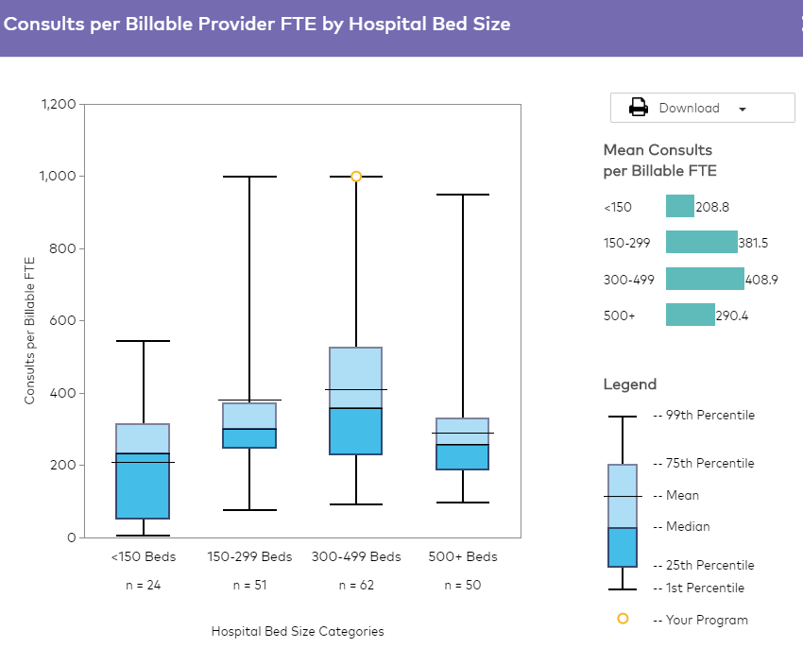
Case Study: St. Mary Medical
Reports with permission from CAPC
Notes:
Their Registry reports demonstrated that they were at the 75th percentile for penetration compared with palliative care programs with a similar staff size and below the 25th percentile for palliative care staffing (staff FTE per 10,000 patients seen), compared with palliative care programs at similarly sized hospitals.
Presenting the comparative data to the C-Suite contributed to their hospital approving 1.0 FTE APRN and 0.2 RN to support their program goals.

Slide 22
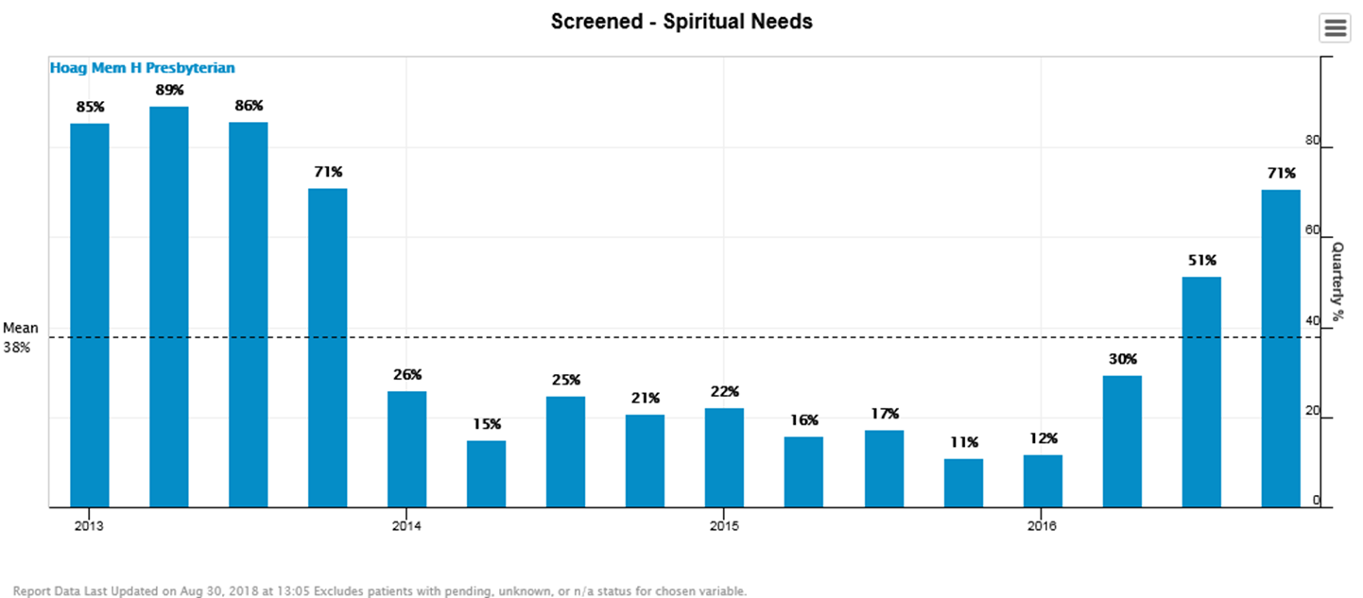
Case Study: Hoag Hospital
Reports with permission from PCQN
Notes:
This is a case from Hoag Hospital in California. They were PCQN participants for many years. In the Collaborative, they identified that they could be doing a better job as a team screening for spiritual needs. They thoughts they were doing it regularly, but the data showed a different story.

Slide 23
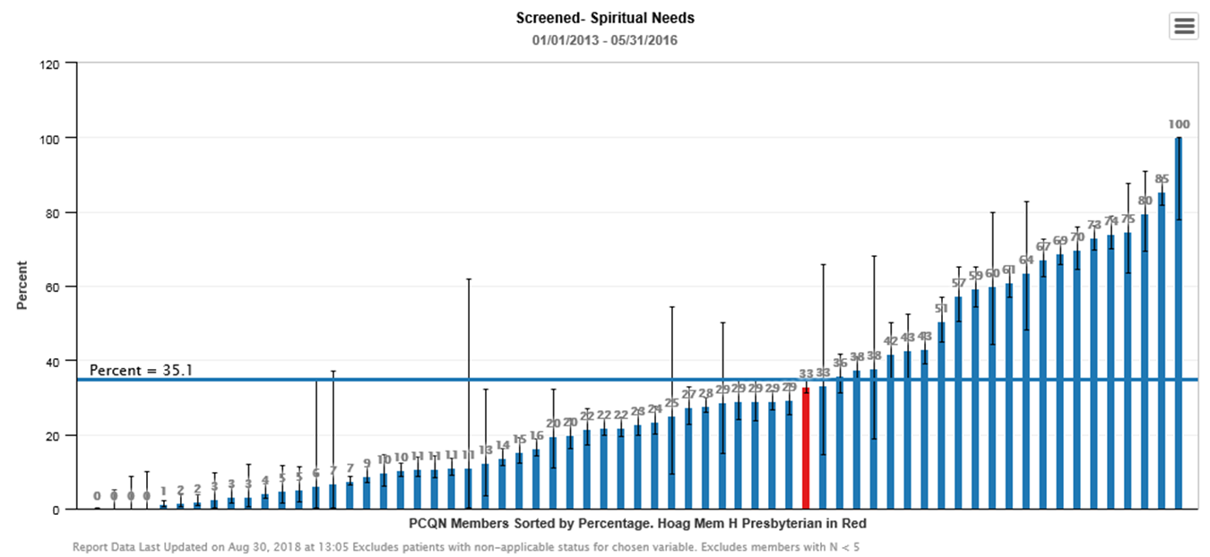
Case Study: Hoag Hospital
Reports with permission from PCQN
Notes:
Through comparative reports, they were able to determine that they weren’t doing too well compared to others in PCQN. The comparative data helped them set attainable goals for spiritual care screening. If you’re just looking at your own data, it can be difficult to know what will be realistic for your team. They then implemented a quality improvement project as a team around spiritual care. They agreed on a set of questions for all clinicians to use and focused on spirituality rather than strictly religion. They collected feedback from their team. They tracked their data over time to see improvements and had monthly calls to stay focused.

Slide 24
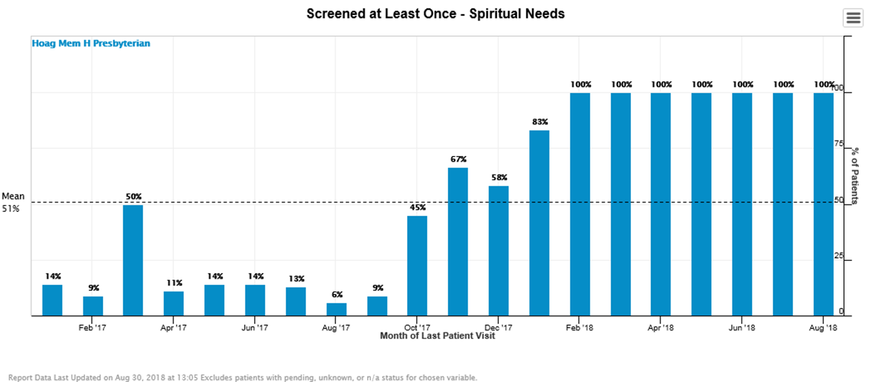
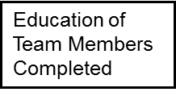

Case Study: Hoag Hospital
Reports with permission from PCQN
Reports with permission from PCQN
Notes:
Once they finished the inpatient QI project around screening for spirituality, they reviewed reports, noticed really low screening…educated on utilization of a screening question that drives this data point. It was an easy fix once we identified the gap through data.

Slide 25

PCQC Mission
Transform healthcare by measuring, defining, and promoting quality palliative care
Improve the quality of care for seriously ill patients and their families
By us, for us

Slide 26


Slide 27






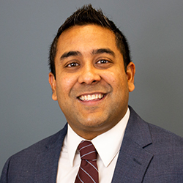
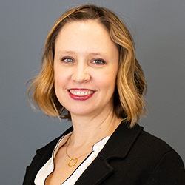
PCQC Board
Melissa D. Aldridge, PhD, MBA, MPH
Mount Sinai
Diane E. Meier, MD
Center to Advance Palliative Care, Mount Sinai
Janet Bull, MD, MBA
Four Seasons
Steven Z. Pantilat, MD
University of California, San Francisco
Kristyn Fazzalaro, LCSW, ACHPSW
Hoag Health Network
Phillip E. Rodgers, MD
University of Michigan, Medical School
Arif H. Kamal, MD, MBA, MHS
Duke University
Rachel Thienprayoon, MD, MSCS
Cincinnati Children’s Hospital

Slide 28
State of the art data registry
Standardized program- and patient-level outcome data
  Informed by national guidelines, MWM, NCP, TJC
  Consensus with extensive input
  Comprehensive, not exhaustive
  Core, Optional, and Customizable items
  Supports standardized assessment
  Feasible, clinically meaningful, prospective
  EHR integration

Slide 29
Data Elements
Program characteristics: disciplines, workload, certification, institution, sites, operations
Patient characteristics: demographics, Dx, reason for consult, referral source
Process of Care: dates, team, screening & interventions
Care Planning: code status, AD & POLST completion
Symptom Scores: ESAS, quality of life
Disposition: status, services

Slide 30

Tier 1
API-based pull connector
APIs vary by EHR; Minimizes site IT involvement
Tier 2
EHR-specific push connector
Format varies by EHR; Site pushes files over standard protocols
Tier 3
ArborMetrix-standard push connector
Site IT generates file conforming to ArborMetrix specification; Site pushes files over standard protocols
Tier 4
Direct manual data entry via website
Notes:
Application programing interface

Slide 31
State of the Art registry
    Standardized program and patient-level outcome data
    EHR integration
    Reports with benchmarking

Slide 32






Reports with benchmarks
Summary
Stats on core & optional data elements
Trend
Over time for user selected measures
Member Comparison
Benchmark reports to appropriate cohorts
Cross-tab
Relationship between two variables
Database Queries
Summary lists of key variables of interest
PRESENTED BY: Kamal, Rotella, Rogers, Pantilat

Slide 33
State of the Art registry
  Standardized program- and patient-level outcome data
  EHR integration
  Reports with benchmarking
  Easier, faster, better and cheaper than doing it on your own

Slide 34
PCQC
State of the art data registry
Community of like-minded people
Practice improvement/QI collaboratives
Research and measure development
Technical assistance

Slide 35
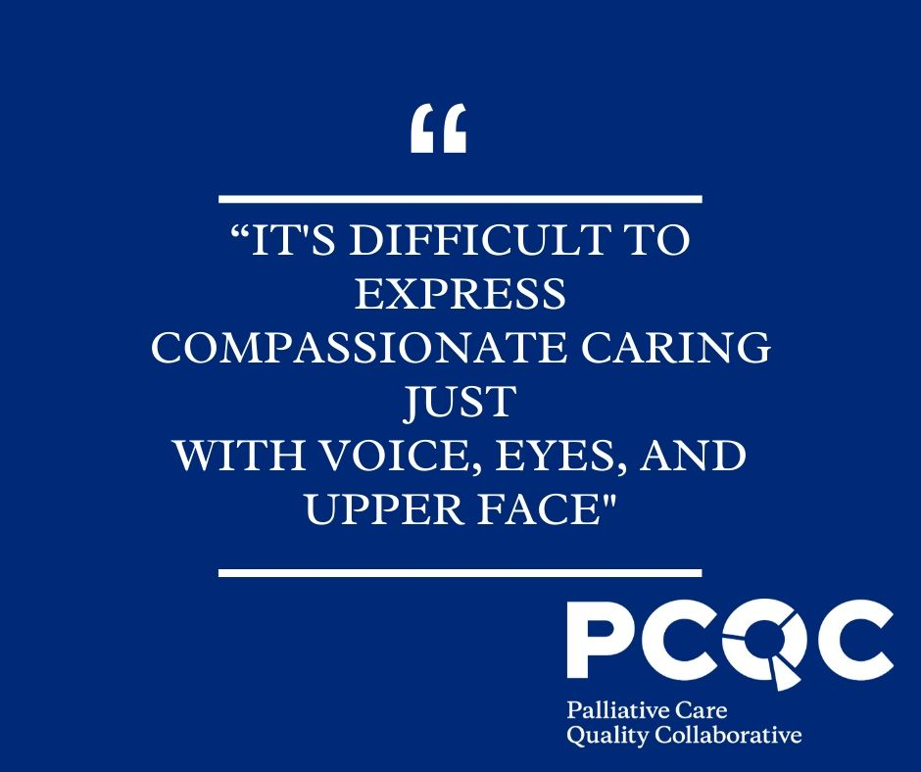
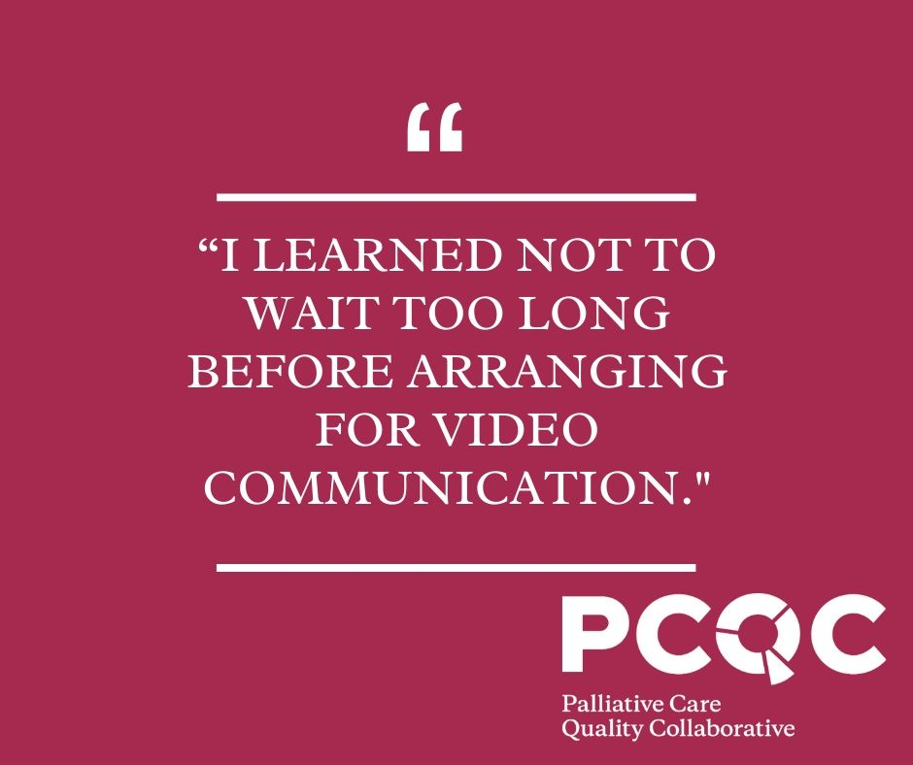
COVID-19 Case Report
Launched April 2020
Collect standardized data and experiences of palliative care clinicians caring for patients with COVID-19, PUI, and those that have recovered
Includes pediatric and adult palliative care
https://www.palliativequality.org/covid-19-case-report
Notes:
In the wake of the COVID-19 crisis, there has been a tremendous amount of uncertainty facing clinicians and administrators throughout our field. In response, the PCQC has developed a short case report form to collate experiences of palliative care clinicians in caring for COVID-19 positive, PUI (Person Under Investigation), and recovered patients. These experiences will be shared with the palliative care community to foster clarity in the field through continuous learning. The case report is for both adult and pediatric palliative care.

Slide 36
Be a Founding member
Program level data and reports: Free
Patient-level data and reports
EHR integration
Community
QI collaborative
$4500/yr for first 2 yrs
and MOU/BAA
Data registry launch August 2020

Slide 37
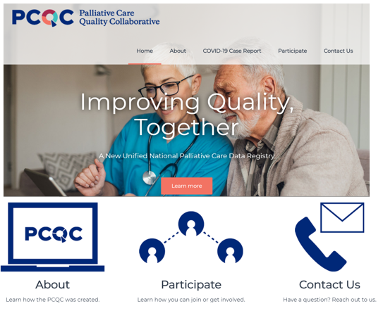

Slide 38
Presenter Contact Information
Arif Kamal arif.kamal@duke.edu | @arifkamalmd
Joe Rotella jrotella@aahpm.org | @JRotellaAAHPM
Maggie Rogers maggie.rogers@mssm.edu | @magthenomad
Steve Pantilat Steve.Pantilat@ucsf.edu | @stevepantilat

Slide 39
Reach out to get more information about the PCQC
Are you a current registry participant with questions? Contact:
Are you a potential PCQC registry participant with questions? Contact:
Global Palliative Care Quality Alliance info@gpcqa.org
National Palliative Care Registry™
research@capc.org
Palliative Care Quality Network
PCQNSupport@ucsf.edu
Palliative Care Quality Collaborative
LanceMueller@palliativequality.org

Slide 40
Palliative Care Quality Collaborative
PalliativeQuality.org
8735 W Higgins Rd
Suite 300
Chicago, IL 60631
@PalliativeQual

Slide 41
PCQC Project Diagram

